Slide 1

PULSEVIEW HIS PROJECT

Slide 2

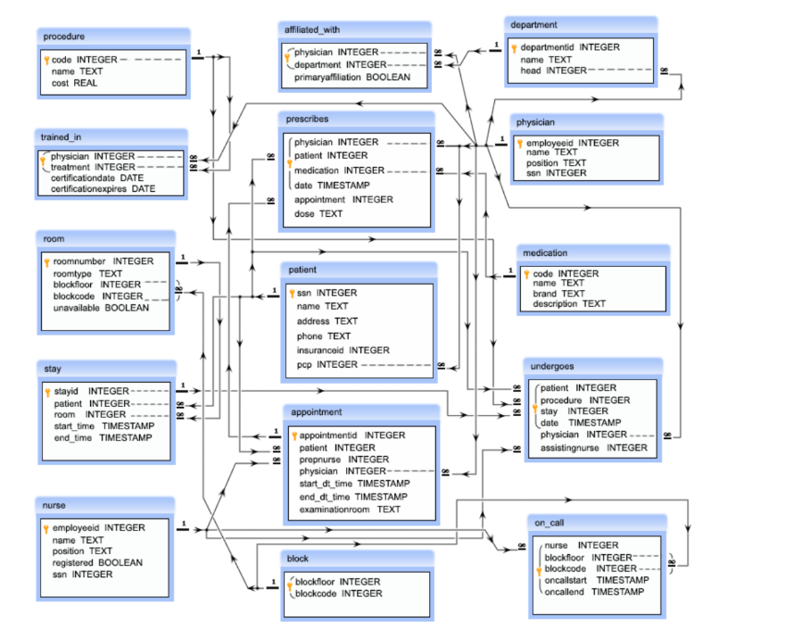
Table Creations

Slide 3
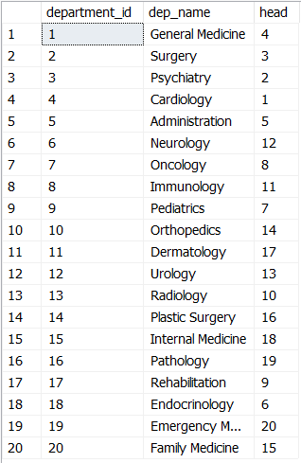
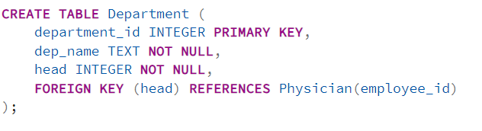
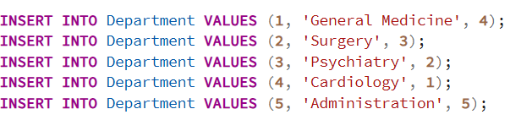
Table Creations

Slide 4
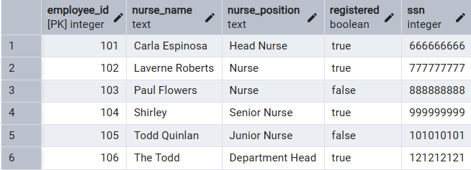

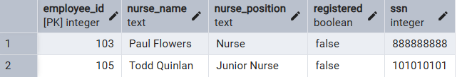
1) Find all information of nurses who are yet to be registered.

Slide 5

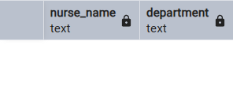
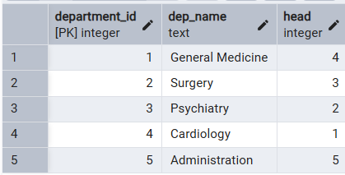
2) Find names of nurses who are department heads

Slide 6

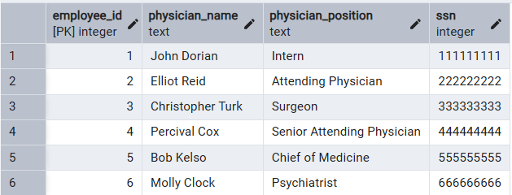
3) Find names of physicians who are department heads

Slide 7
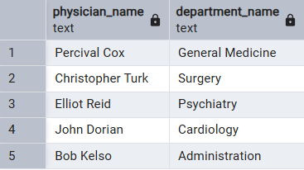
3) Find names of physicians who are department heads

Slide 8
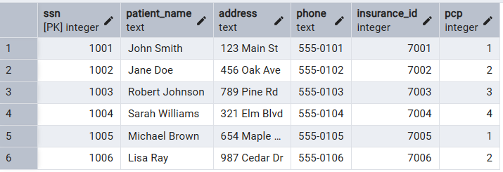
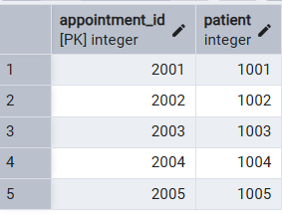
4) Count patients who have taken at least one appointment

Slide 9

4) Count patients who have taken at least one appointment

Slide 10
4) Count patients who have taken at least one appointment

Slide 11

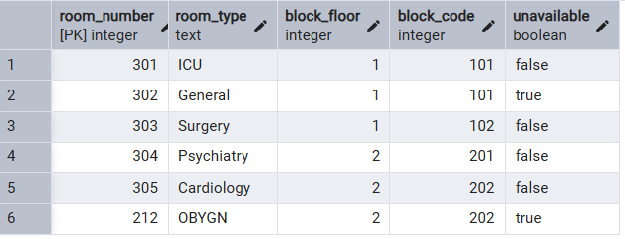

5) Find floor and block for room number 212

Slide 12

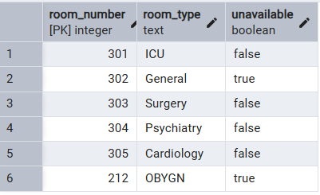

6) Count the number of available rooms

Slide 13


7) Count the number of unavailable rooms

Slide 14
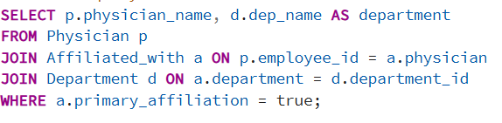
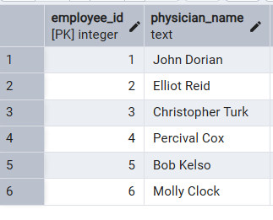
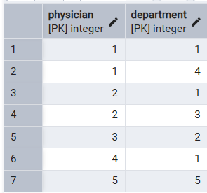
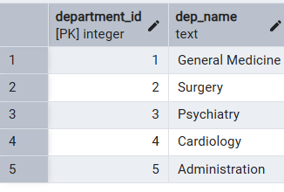
8) Get physician names and their affiliated departments

Slide 15
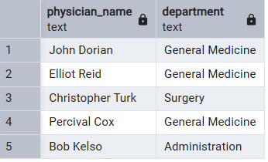
8) Get physician names and their affiliated departments

Slide 16
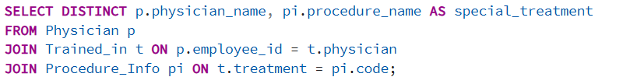
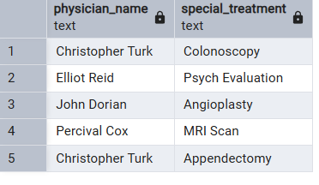
9) Get physicians trained for special treatments

Slide 17
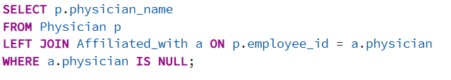
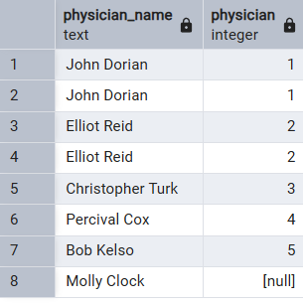

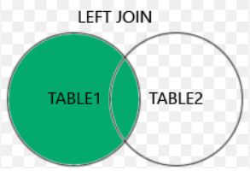
10) Get physicians with department who are yet to be affiliated

Slide 18
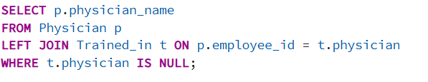
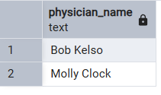
11) Get physicians who are not specialized

Slide 19
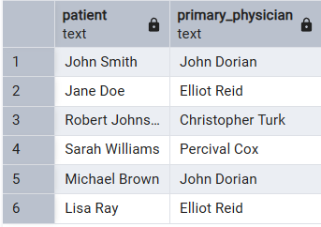
12) Get patients with their primary care physicians

Slide 20
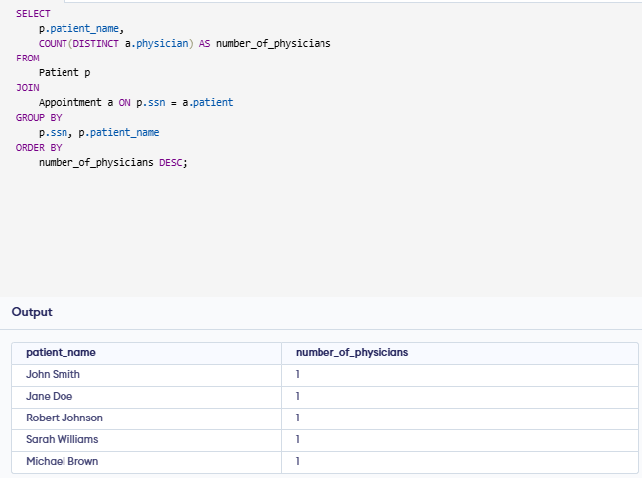
13) FIND THE NAME OF THE PATIENTS AND THE NUMBER OF PHYSICIANS THEY HAVE TAKEN APPOINTMENT.

Slide 21
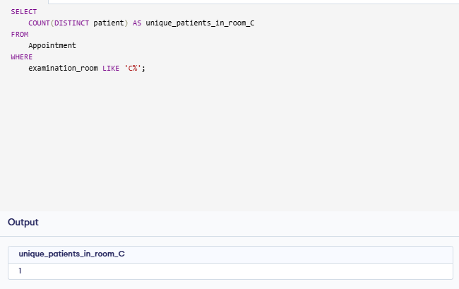
14) COUNT NUMBER OF UNIQUE PATIENTS WHO GOT AN APPOINTMENT FOR EXAMINATION ROOM C.

Slide 22
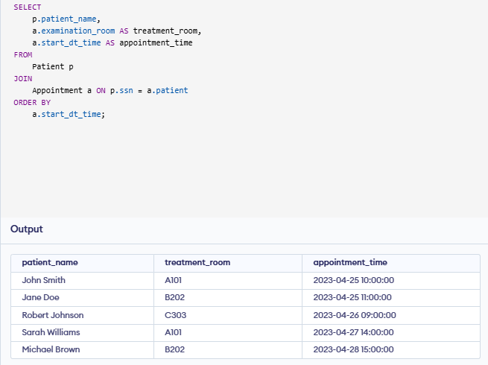
15) NAME OF THE PATIENTS AND THE NUMBER OF THE ROOM WHERE THEY HAVE TO GO FOR THEIR TREATMENT.

Slide 23
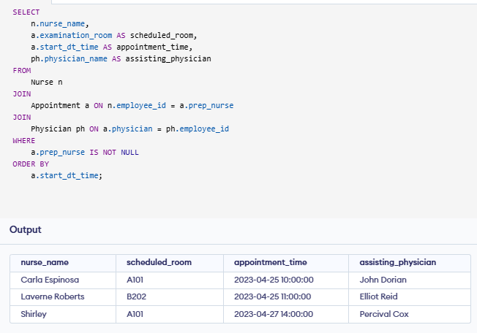
16) FIND THE NAME OF THE NURSES AND THE ROOM SCHEDULED, WHERE THEY WILL ASSIST THE PHYSICIANS.

Slide 24
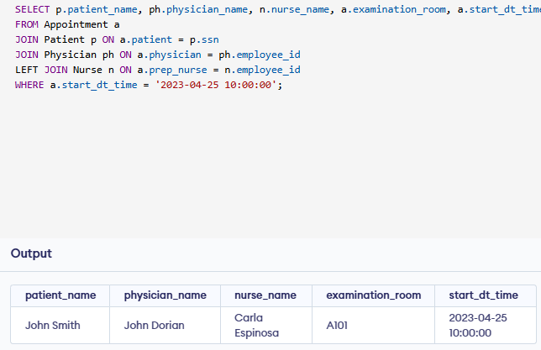
17) FIND THE NAME OF THE PATIENTS WHO TOOK THE APPOINTMENT ON THE 25TH OF APRIL AT 10 AM, AND ALSO DISPLAY THEIR PHYSICIAN, ASSISTING NURSES AND ROOM NO.

Slide 25
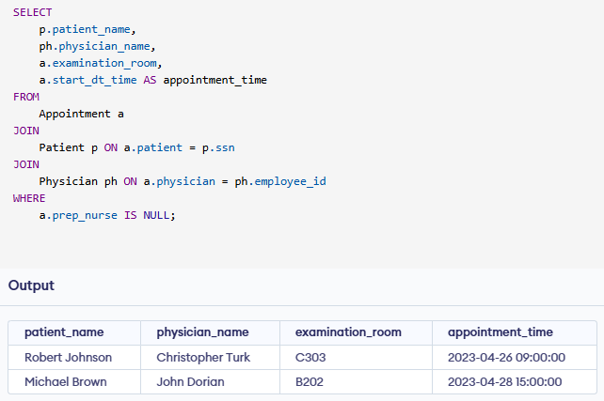
18) FIND THE NAME OF PATIENTS AND THEIR PHYSICIANS WHO DO NOT REQUIRE ANY ASSISTANCE OF A NURSE.

Slide 26
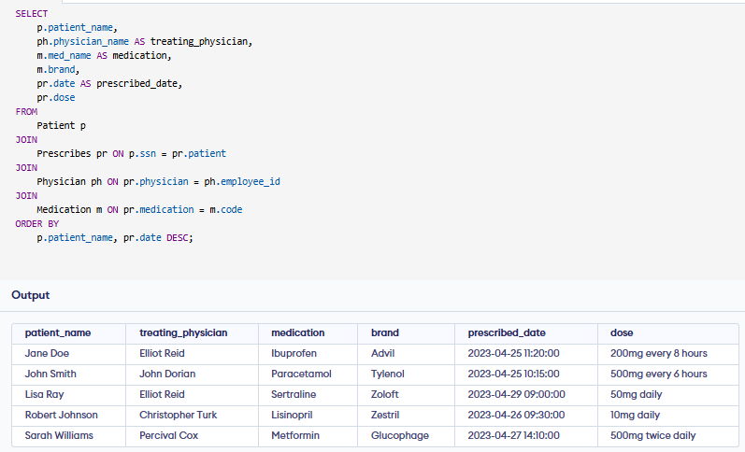
19) FIND THE NAME OF THE PATIENTS, THEIR TREATING PHYSICIANS AND MEDICATION.

Slide 27
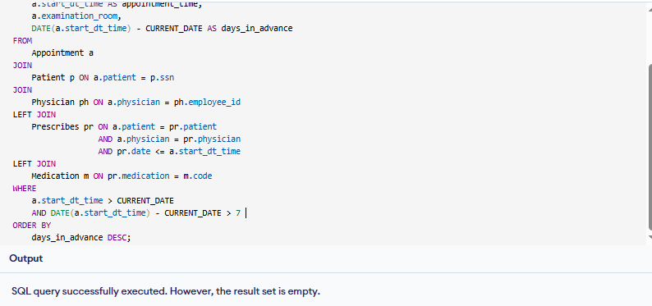
20) NAME OF THE PATIENTS WHO TOOK AN ADVANCED APPOINTMENT, THEIR PHYSICIANS AND MEDICATION.

Slide 28
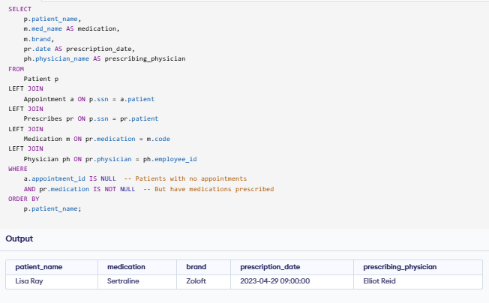
21) FIND THE NAME AND MEDICATION FOR THOSE PATIENTS WHO DID NOT TAKE ANY APPOINTMENT.

Slide 29
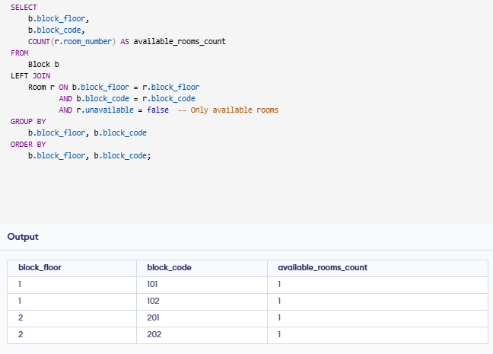
22) COUNT THE NUMBER OF AVAILABLE ROOMS IN EACH BLOCK.

Slide 30
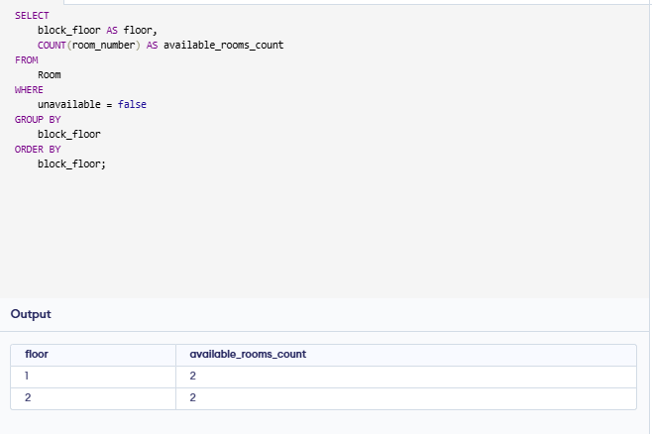
23) COUNT THE NUMBER OF AVAILABLE ROOMS IN EACH FLOOR.

Slide 31
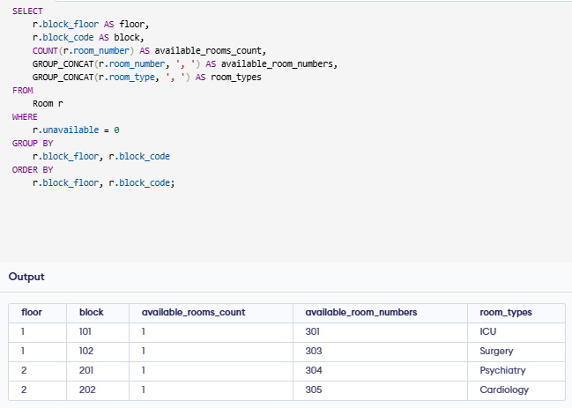
24) COUNT THE NUMBER OF AVAILABLE ROOMS FOR EACH BLOCK IN EACH FLOOR.

Slide 32
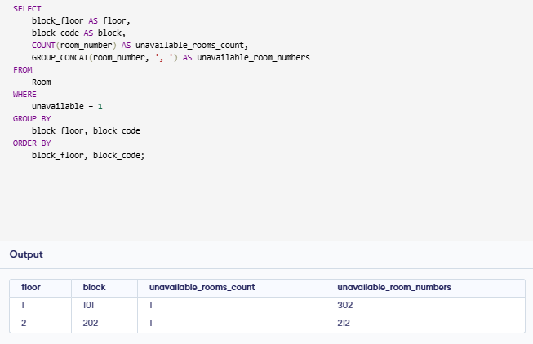
25) COUNT THE NUMBER OF UNAVAILABLE ROOMS FOR EACH BLOCK IN EACH FLOOR.

Slide 33
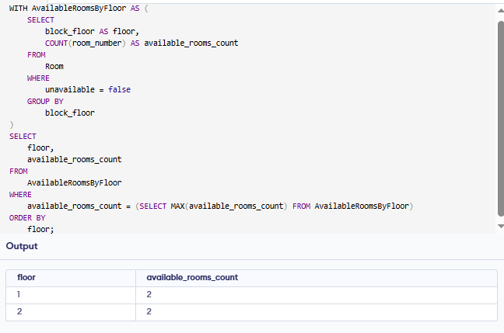
26) FIND OUT THE FLOOR WHERE THE MAXIMUM NUMBER OF ROOMS ARE AVAILABLE.

Slide 34
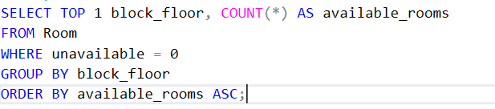

27) WRITE A QUERY IN SQL TO FIND OUT THE FLOOR WHERE THE MINIMUM NO OF ROOMS ARE AVAILABLE

Slide 35
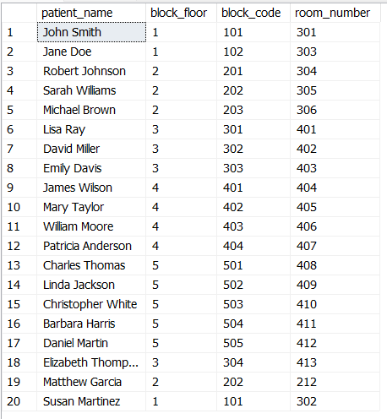
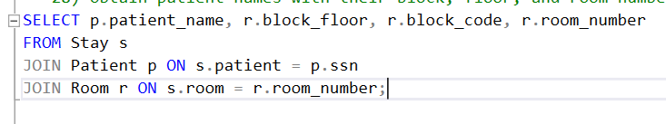
28) OBTAIN THE NAME OF THE PATIENTS, THEIR BLOCK, FLOOR, AND ROOM NUMBER WHERE THEY ARE ADMITTED.

Slide 36
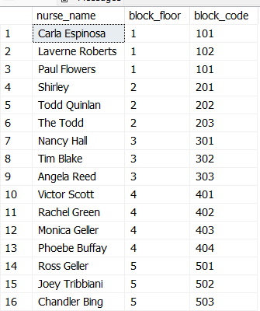

29) OBTAIN THE NURSES AND THE BLOCK WHERE THEY ARE BOOKED FOR ATTENDING THE PATIENTS ON CALL.

Slide 37
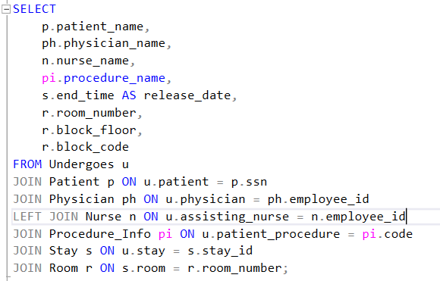
30) PATIENT NAME, PHYSICIAN, NURSE, TREATMENT, RELEASE DATE, ROOM, FLOOR, BLOCK.

Slide 38
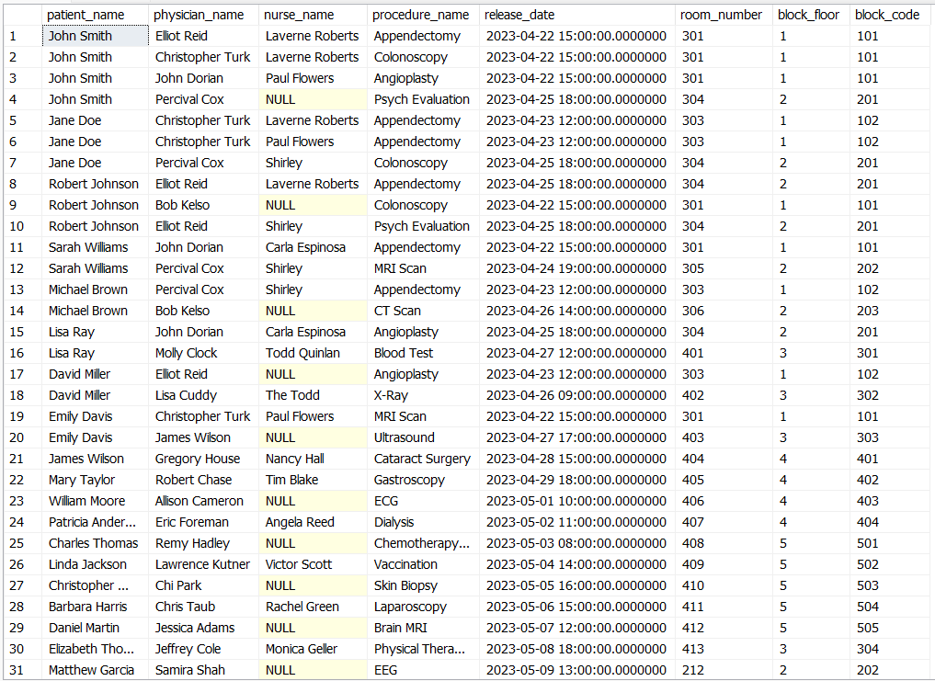

Slide 39
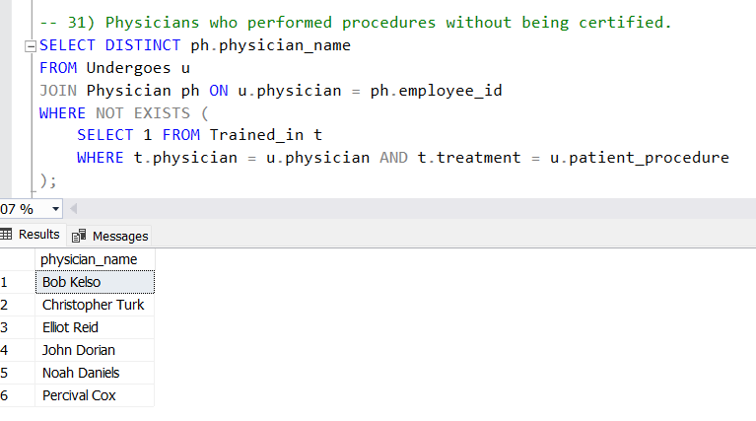
31) PHYSICIANS WHO PERFORMED PROCEDURES WITHOUT BEING CERTIFIED.

Slide 40
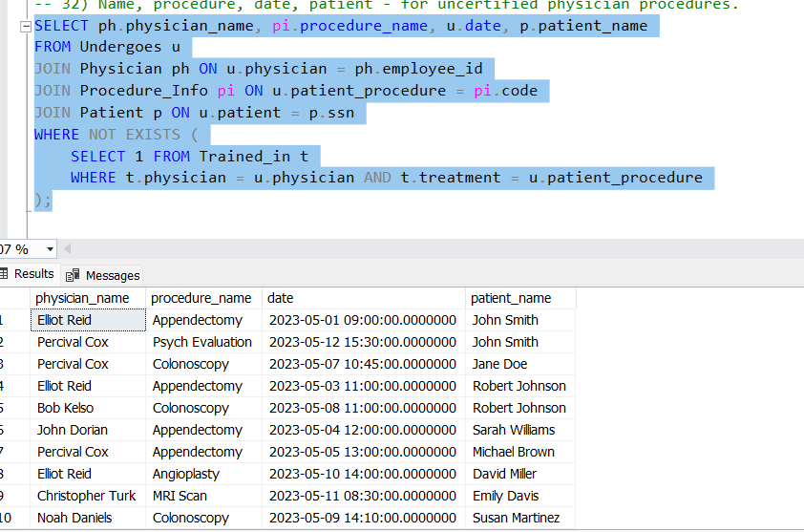
32) NAME, PROCEDURE, DATE, PATIENT - FOR UNCERTIFIED PHYSICIAN PROCEDURES

Slide 41
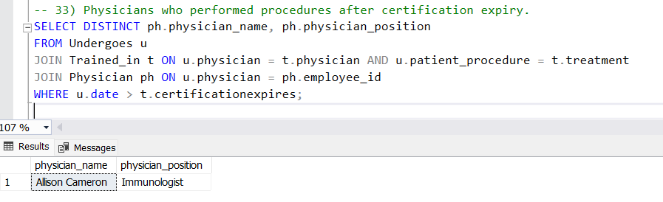
33) PHYSICIANS WHO PERFORMED PROCEDURES AFTER CERTIFICATION EXPIRY.

Slide 42

34) PHYSICIAN, PROCEDURE, PATIENT, DATE WHEN CERTIFICATION EXPIRED.

Slide 43

35) NURSES WHO HAVE EVER BEEN ON CALL IN THE BLOCK OF ROOM 122.

Slide 44

36) PATIENTS WHO WERE PRESCRIBED MEDICATION BY THEIR PCP.

Slide 45

37) PATIENTS WHO UNDERWENT PROCEDURES > 5000 AND THEIR PCP.

Slide 46

38) PATIENTS WITH AT LEAST TWO APPOINTMENTS WITH A REGISTERED NURSE.

Slide 47

39) PATIENTS WHOSE PCP IS NOT THE HEAD OF ANY DEPARTMENT.

Slide 48

POWERBI DASHBOSRD

Slide 49

THANK YOU
QUESTIONS?
THANK YOU

